Slide 1

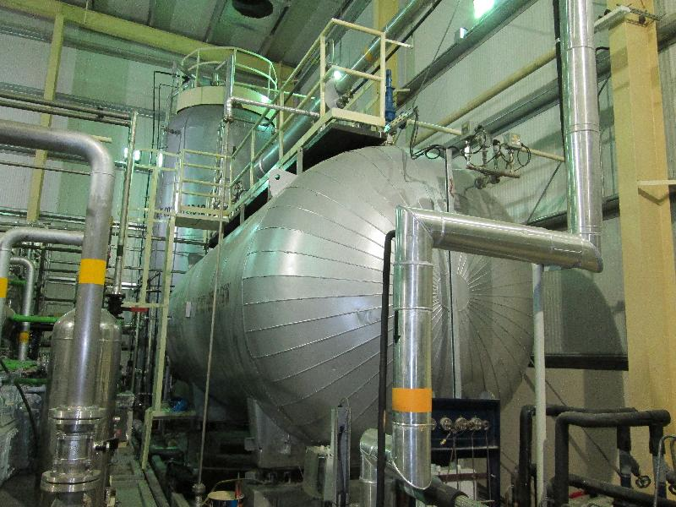

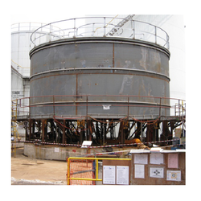
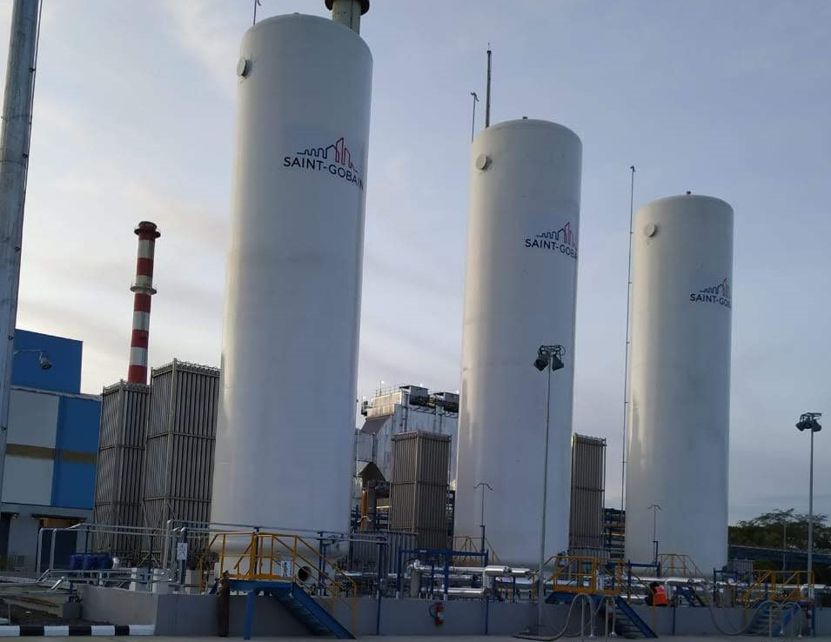

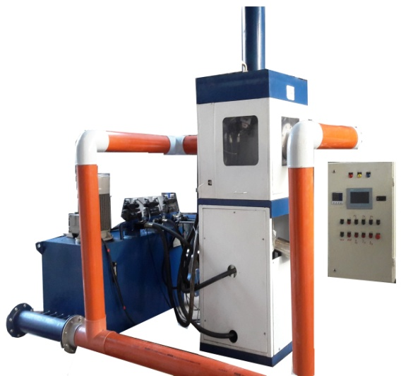
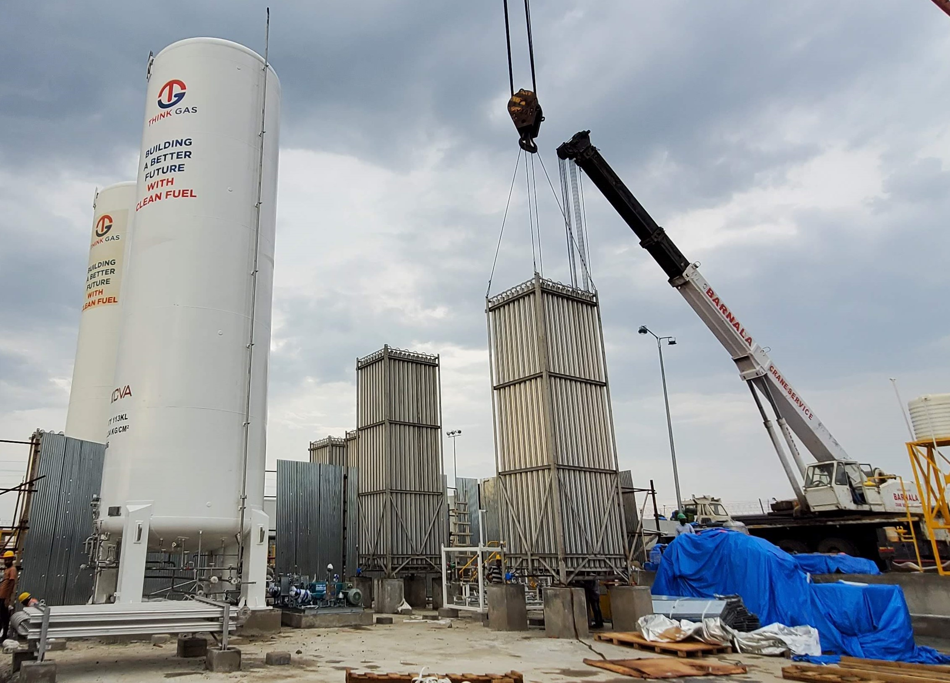


RIZQTECH ENGINEERS
A CONSULTING DESGIN & MANUFACTURING FIRM
COMPANY PROFILE
(An ISO 9001:2015 Company)
WORKS IT:
486/2 GIDC,
MAKRPURA,
VADODARA-390010
GUJARAT, INDIA
PHONE NO:+91-7600807606
+91-9624690662
E-MAIL: info@rizqtech.co.in
rizq_tech@yahoo.com
WEBSITE: www.riztechengineers.com
ISO 9001:2015
ISO 45001:2018

Slide 2
RIZQTECH ENGINEERS
A CONSULTING DESGIN & MANUFACTURING FIRM
INTRODUCTION
RIZQTECH ENGINEERS as a specialist in All kind of Machining, Fabrication of steel Structure, Design and Manufacturing of Storage tanks, Piping, Dry Ice Block machine, Dry Ice Pellets machine , pressure vessels,skids, filling pump and Industrial Supply, services to a growing market in the industrial and private sector. Today due to the strict policies in terms of quality control in specialized services, Highly qualified technical personnel, supervised and operated certified engineers.
Our teams well qualified engineers having excellent record in the field of design, manufacture of these products in accordance with the set market norms using supreme grade raw material and latest technology. The raw material we use to manufacture these products is sourced from reliable vendors of the market. These products are extensively demanded all across the globe due to their features like ability to withstand harsh conditions, optimum performance, high strength, easy installation and durability.
M/s RIZQTECH ENGINEERS is Located at Vadodara (Gujarat, India), we have developed a high-end infrastructure that is spread sprawling area. Installed with latest tools and technology, our infrastructure is segregated into different departments such as manufacturing, quality control, R&D, warehousing & packaging, etc. To maintain the consistency in quality of our products, we have arranged a dependable quality testing unit that is manned by experienced quality professionals. Our quality controllers inspect each and every product on various industry parameters like finishing, designing, stitching, etc. to avoid any kind of discrepancy. In order to achieve a high level of satisfaction of our clients, we fabricate these products in tandem with the specifications laid down by them. Also, our extensive distribution network helps us in delivering these products at clients’ end in a timely manner. Owing to our ethical business policies, prompt delivery, competitive price structure and client & quality centric approach, we are constantly progressing in the industry.
QUALITY ASSURANCE
The sole objective of our firm is to offer the optimum quality products to our valuable clients. We attain this objective by completing all activities in an efficient and prompt manner. Our team of quality controllers severely checks all products on defined parameters to eliminate all the flawless products. Offered products are fabricated under the supervision of our experienced professionals using high grade raw material. Also, these products are checked by our quality controllers on several quality parameters.
WORKS IT:
486/2 GIDC,
MAKRPURA,
VADODARA-390010
GUJARAT, INDIA
PHONE NO:+91-7600807606
+91-9624690662
E-MAIL: info@rizqtech.co.in
rizq_tech@yahoo.com
WEBSITE: www.riztechengineers.com
ISO 9001:2015
ISO 45001:2018

Slide 3

RIZQTECH ENGINEERS
A CONSULTING DESGIN & MANUFACTURING FIRM
The RIZQTECH ENGINEERS Is Continuously Developing And Improving Manufacturing Methods To Ensure The Highest Possible Level Of Value, Quality And Products To Meet Our Clients’ Needs.
The sole objective of our firm is to offer the optimum quality products to our valuable clients. We attain this objective by completing all activities in an efficient and prompt manner. Our team of quality controllers severely checks all products on defined parameters to eliminate all the flawless products. Offered products are fabricated under the supervision of our experienced professionals using high grade raw material. Also, these products are checked by our quality controllers on several quality parameters.
To Become The Most Respected And Prominent Manufacturing & Service Company In Industry- Known For Our Dedication To Excellence In Everything We Do.
WORKS IT:
486/2 GIDC,
MAKRPURA,
VADODARA-390010
GUJARAT, INDIA
PHONE NO:+91-7600807606
+91-9624690662
E-MAIL: info@rizqtech.co.in
rizq_tech@yahoo.com
WEBSITE: www.riztechengineers.com
ISO 9001:2015
ISO 45001:2018

Slide 4
RIZQTECH ENGINEERS
A CONSULTING DESGIN & MANUFACTURING FIRM
SAFETY
RIZQTECH is dedicated to protecting and preserving the working environment in a responsible manner - we are very proud of how we work and our safety track record.
When it comes to safety, our philosophy is that any successful job or project is directly attributed to exceptional performance and well-planned services. Our unmatched safety record is a result of avoiding less than desirable workmanship and errors associated with rushing, stress, and poor work conditions. The majority of incidences are attributed to human error, thus minimizing or eliminating such conditions results in fewer incidents.
Rizqtech’s management is committed to continuous development and improvement of safety programs to protect our team members on all job sites. We also acknowledge that our company’s staff and professionals are our biggest asset. We are proud of our safety record, and continue to strive to make our facilities and job sites safer. We will never compromise the safety of our staff, equipment or our customers.
Rizqtech adheres to all Occupational Safety, Health Compliance associated with our internal proprietary safety program. This compliance assures our company members and clients that all business practices are performed in a safe manner, matching our corporate values and practices.
WORKS IT:
486/2 GIDC,
MAKRPURA,
VADODARA-390010
GUJARAT, INDIA
PHONE NO:+91-7600807606
+91-9624690662
E-MAIL: info@rizqtech.co.in
rizq_tech@yahoo.com
WEBSITE: www.riztechengineers.com
ISO 9001:2015
ISO 45001:2018

Slide 5
RIZQTECH ENGINEERS
A CONSULTING DESGIN & MANUFACTURING FIRM
RANGE OF
PRODUCT
STORAGE TANK & PRESSURE VESSELS
DRY ICE BLOCK MACHINE
DRY ICE PELLETIZER MACHINE
SKIDS
POWER PACK & HYDRAULIC CYLINDERS
WORKS IT:
486/2 GIDC,
MAKRPURA,
VADODARA-390010
GUJARAT, INDIA
PHONE NO:+91-7600807606
+91-9624690662
E-MAIL: info@rizqtech.co.in
rizq_tech@yahoo.com
WEBSITE: www.riztechengineers.com
ISO 9001:2015
ISO 45001:2018

Slide 6
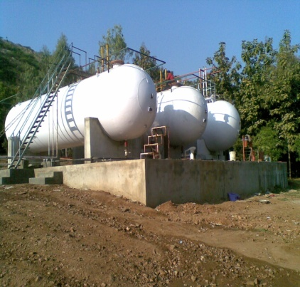
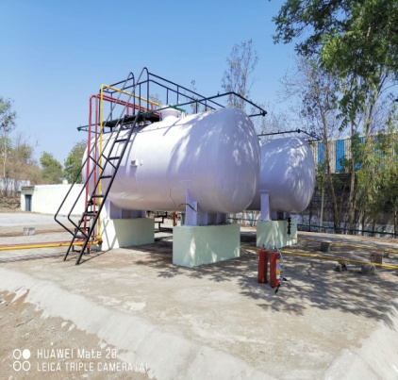
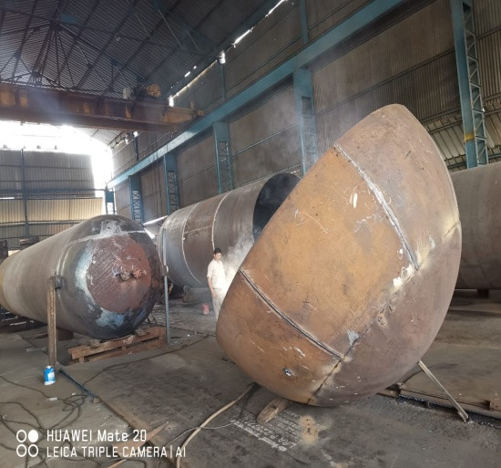
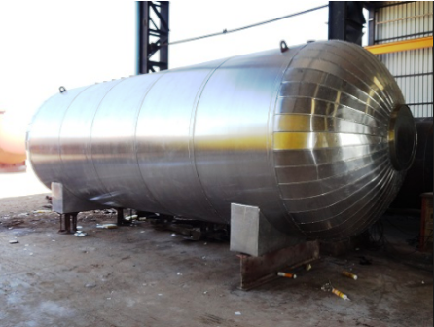
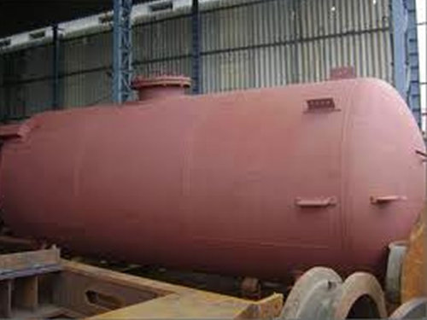
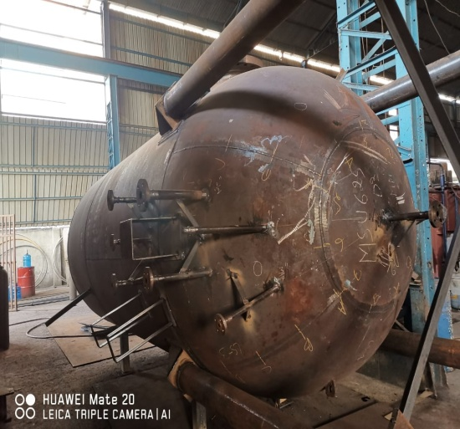
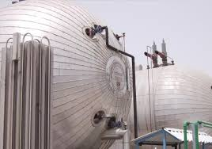
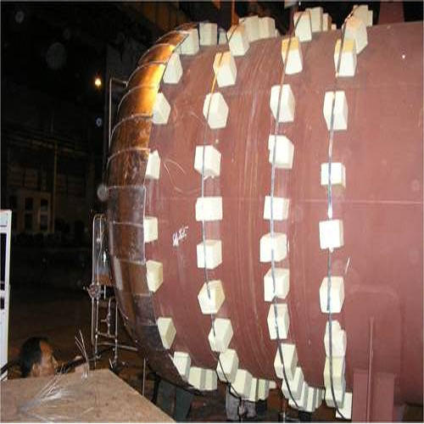
RIZQTECH ENGINEERS
A CONSULTING DESGIN & MANUFACTURING FIRM
STORAGE TANKS AND PRESSURE VESSLES
WORKS IT:
486/2 GIDC,
MAKRPURA,
VADODARA-390010
GUJARAT, INDIA
PHONE NO:+91-7600807606
+91-9624690662
E-MAIL: info@rizqtech.co.in
rizq_tech@yahoo.com
WEBSITE: www.riztechengineers.com
ISO 9001:2015
ISO 45001:2018

Slide 7


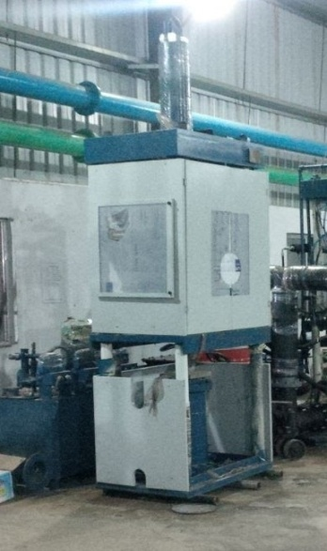
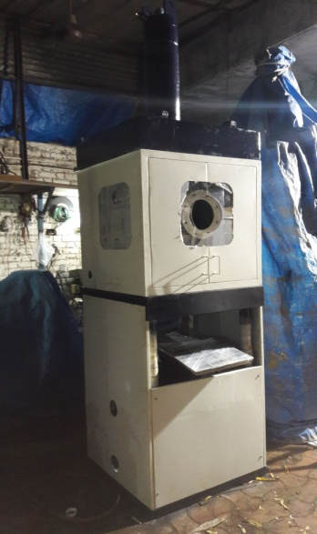
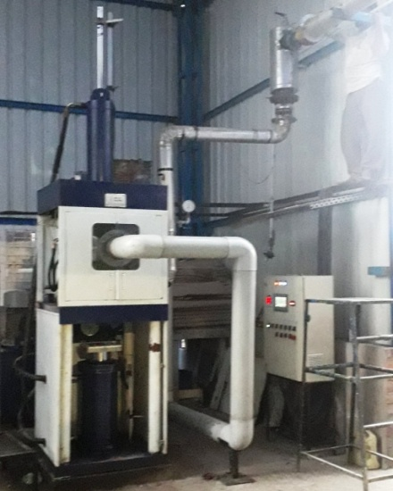
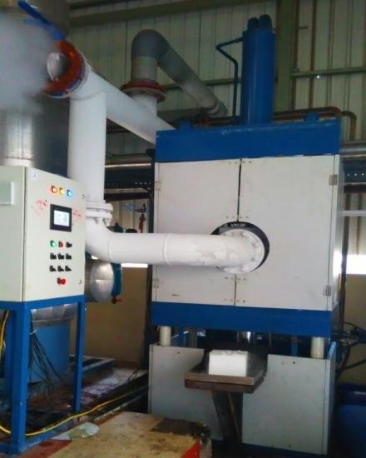
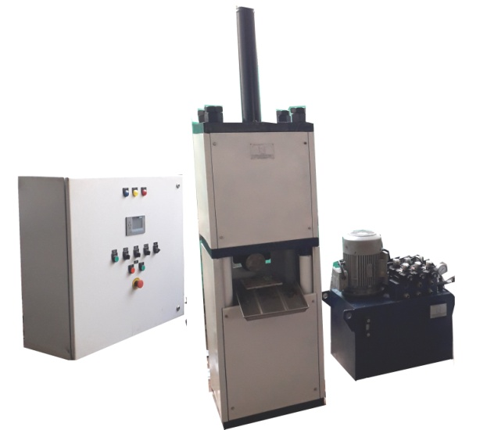
RIZQTECH ENGINEERS
A CONSULTING DESGIN & MANUFACTURING FIRM
DRY ICE BLOCK MACHINES
WORKS IT:
486/2 GIDC,
MAKRPURA,
VADODARA-390010
GUJARAT, INDIA
PHONE NO:+91-7600807606
+91-9624690662
E-MAIL: info@rizqtech.co.in
rizq_tech@yahoo.com
WEBSITE: www.riztechengineers.com
ISO 9001:2015
ISO 45001:2018

Slide 8

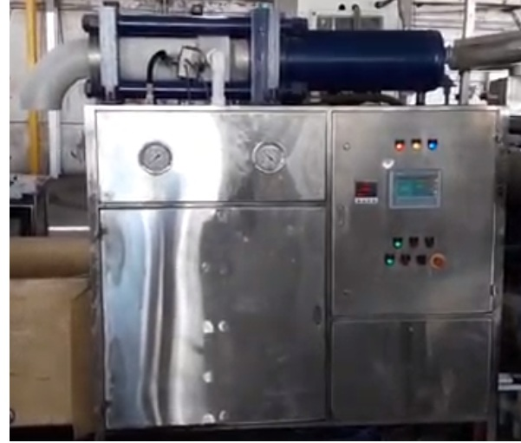
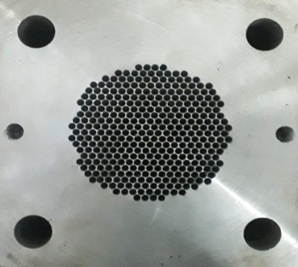
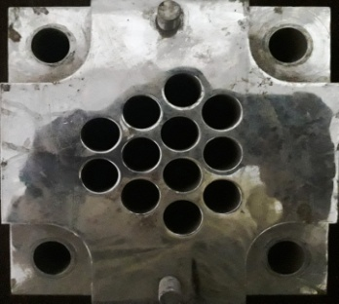
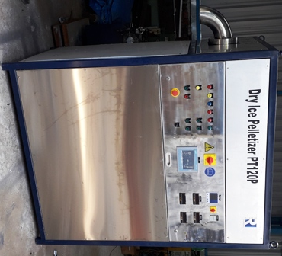
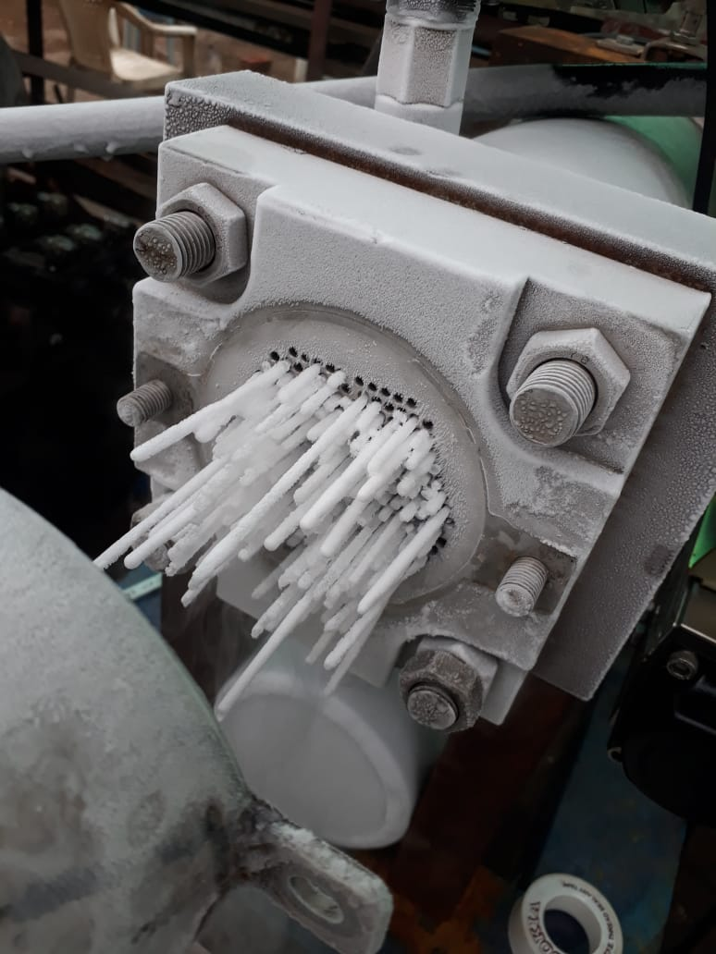
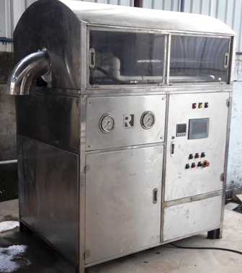
RIZQTECH ENGINEERS
A CONSULTING DESGIN & MANUFACTURING FIRM
DRY ICE PELLETS MACHINES
WORKS IT:
486/2 GIDC,
MAKRPURA,
VADODARA-390010
GUJARAT, INDIA
PHONE NO:+91-7600807606
+91-9624690662
E-MAIL: info@rizqtech.co.in
rizq_tech@yahoo.com
WEBSITE: www.riztechengineers.com
ISO 9001:2015
ISO 45001:2018

Slide 9
RIZQTECH ENGINEERS
A CONSULTING DESGIN & MANUFACTURING FIRM
OUR
SERVICES
Our goal is to continue the development of our long term business relations by delivering quality workmanship, efficient production at a competitive cost, while making customer satisfaction our top priority.
SERVICE AREAS
TURNKEY TANK AND SERVICES
STORAGE TANKS
STORAGE TANKS REPAIRS AND MAINTENANCE
MECHANICAL AND PIPING
STEEL FABRICATION AND ERECTION
PRESSURE VESSEL REPAIRS AND ALTERATION
CONSTRUCTION
FABRICATION
SURFACE PREPARATION AND CLEANING
ELECTRICAL AND INSTRUMENTATION
CERTIFIED AND QUALIFIED MANPOWER
WORKS IT:
486/2 GIDC,
MAKRPURA,
VADODARA-390010
GUJARAT, INDIA
PHONE NO:+91-7600807606
+91-9624690662
E-MAIL: info@rizqtech.co.in
rizq_tech@yahoo.com
WEBSITE: www.riztechengineers.com
ISO 9001:2015
ISO 45001:2018

Slide 10
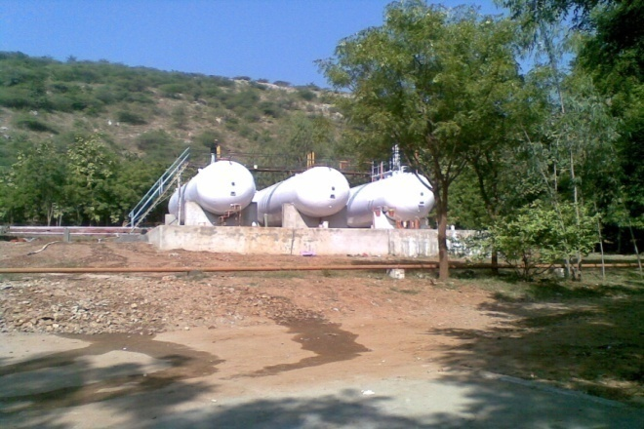

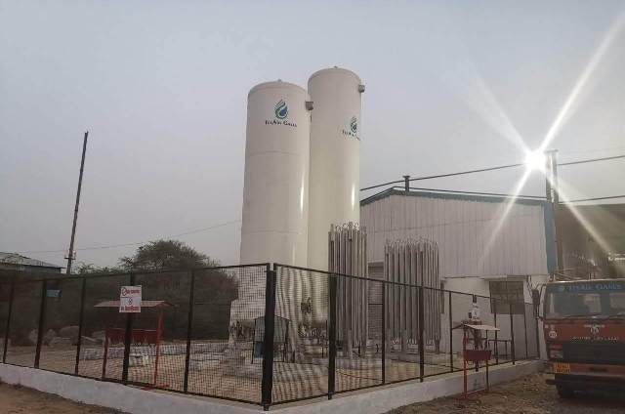
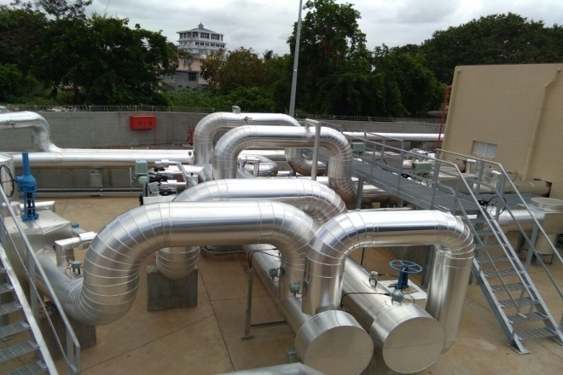
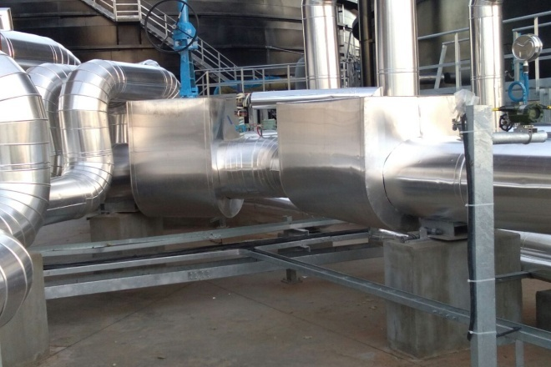
RIZQTECH ENGINEERS
A CONSULTING DESGIN & MANUFACTURING FIRM
PHOTO BOOK
WORKS IT:
486/2 GIDC,
MAKRPURA,
VADODARA-390010
GUJARAT, INDIA
PHONE NO:+91-7600807606
+91-9624690662
E-MAIL: info@rizqtech.co.in
rizq_tech@yahoo.com
WEBSITE: www.riztechengineers.com
ISO 9001:2015
ISO 45001:2018

Slide 11
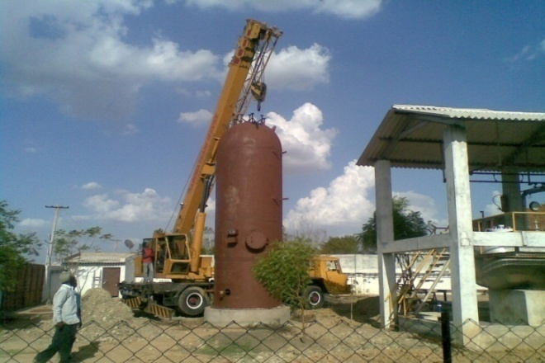
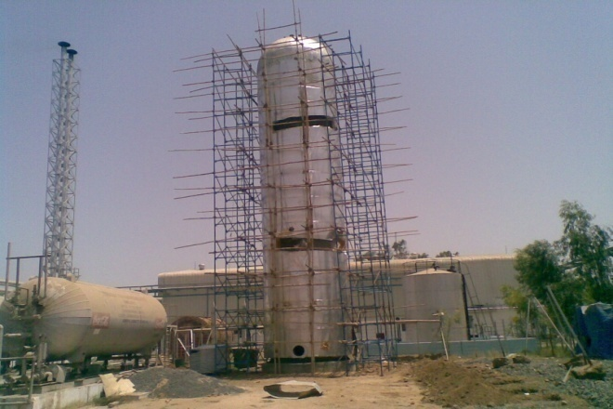
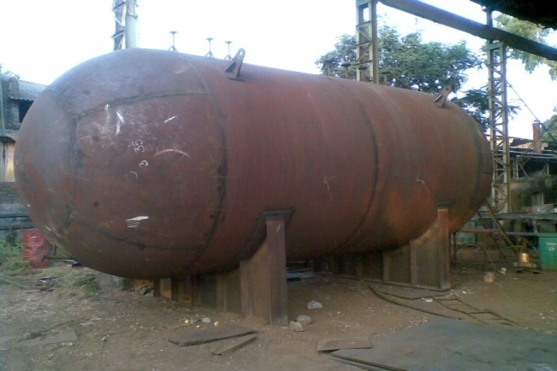
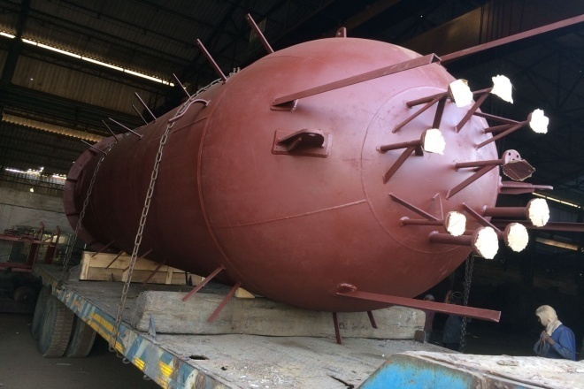
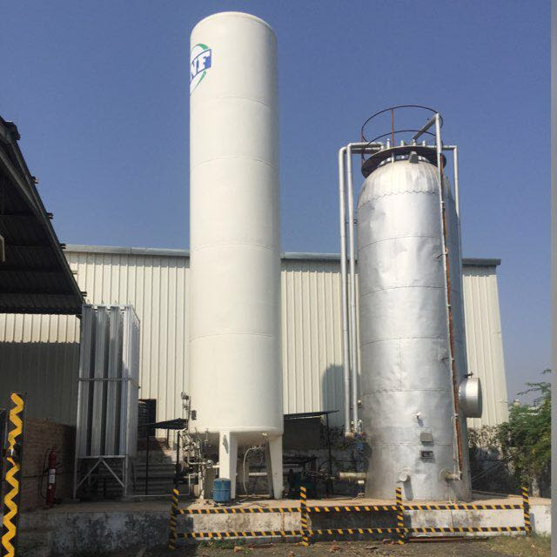
RIZQTECH ENGINEERS
A CONSULTING DESGIN & MANUFACTURING FIRM
PHOTO BOOK
WORKS IT:
486/2 GIDC,
MAKRPURA,
VADODARA-390010
GUJARAT, INDIA
PHONE NO:+91-7600807606
+91-9624690662
E-MAIL: info@rizqtech.co.in
rizq_tech@yahoo.com
WEBSITE: www.riztechengineers.com
ISO 9001:2015
ISO 45001:2018

Slide 12
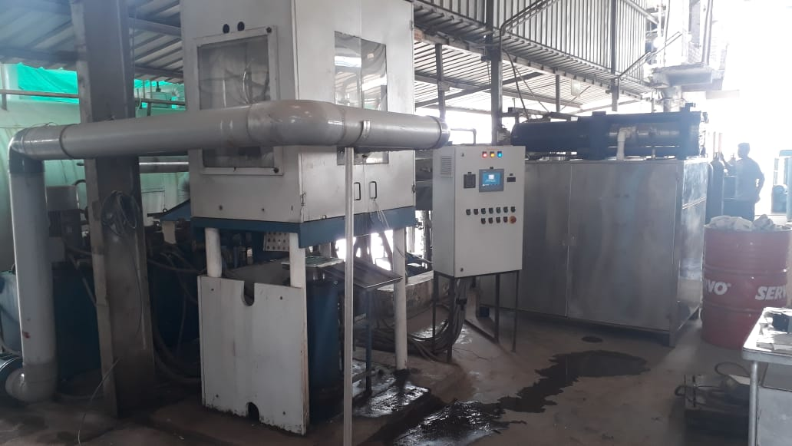
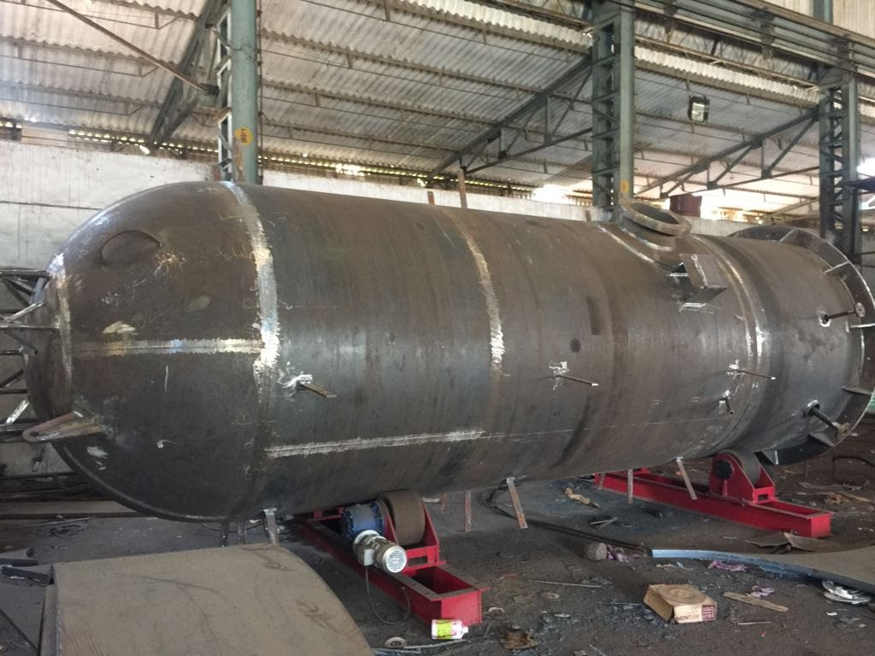
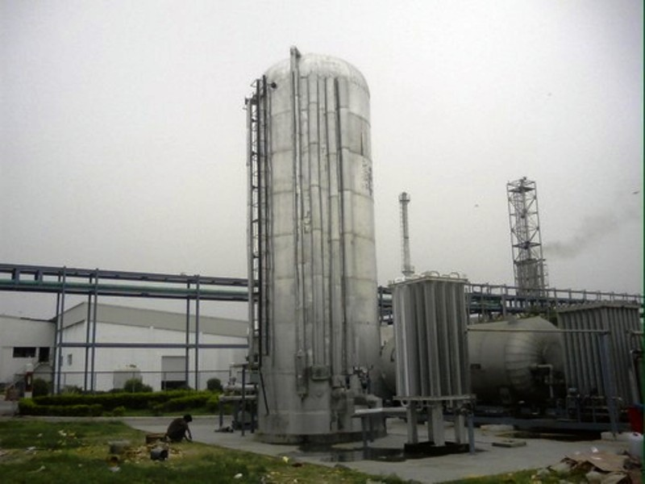
RIZQTECH ENGINEERS
A CONSULTING DESGIN & MANUFACTURING FIRM
PHOTO BOOK
WORKS IT:
486/2 GIDC,
MAKRPURA,
VADODARA-390010
GUJARAT, INDIA
PHONE NO:+91-7600807606
+91-9624690662
E-MAIL: info@rizqtech.co.in
rizq_tech@yahoo.com
WEBSITE: www.riztechengineers.com
ISO 9001:2015
ISO 45001:2018

Slide 13
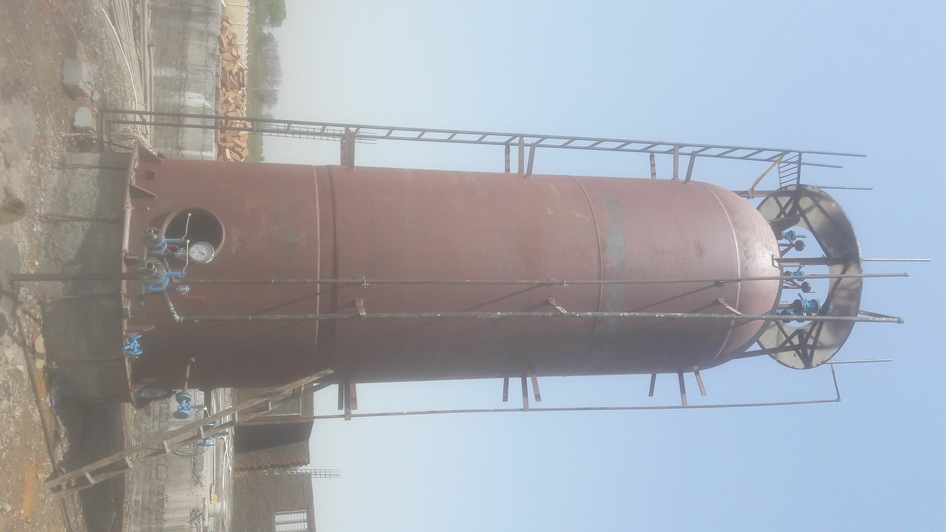
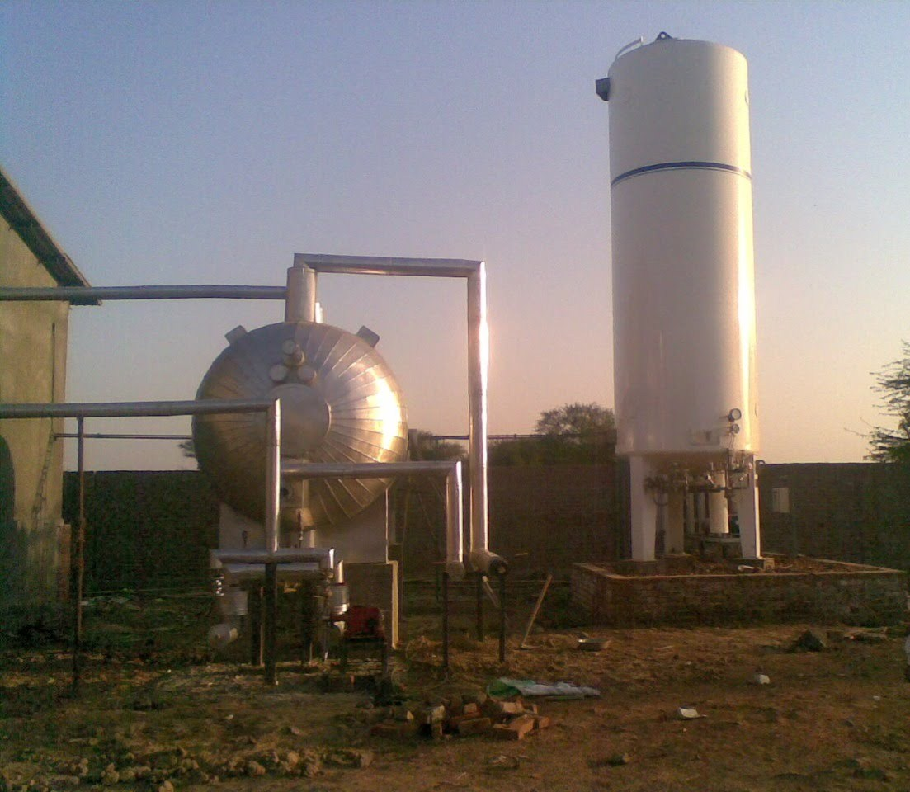
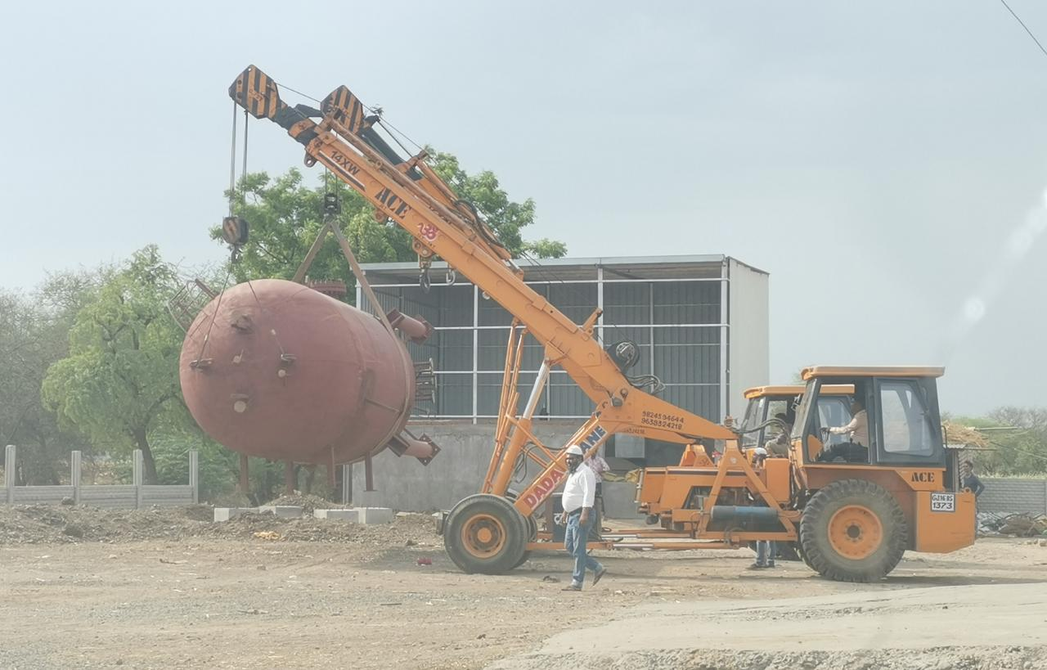
RIZQTECH ENGINEERS
A CONSULTING DESGIN & MANUFACTURING FIRM
PHOTO BOOK
WORKS IT:
486/2 GIDC,
MAKRPURA,
VADODARA-390010
GUJARAT, INDIA
PHONE NO:+91-7600807606
+91-9624690662
E-MAIL: info@rizqtech.co.in
rizq_tech@yahoo.com
WEBSITE: www.riztechengineers.com
ISO 9001:2015
ISO 45001:2018

Slide 14
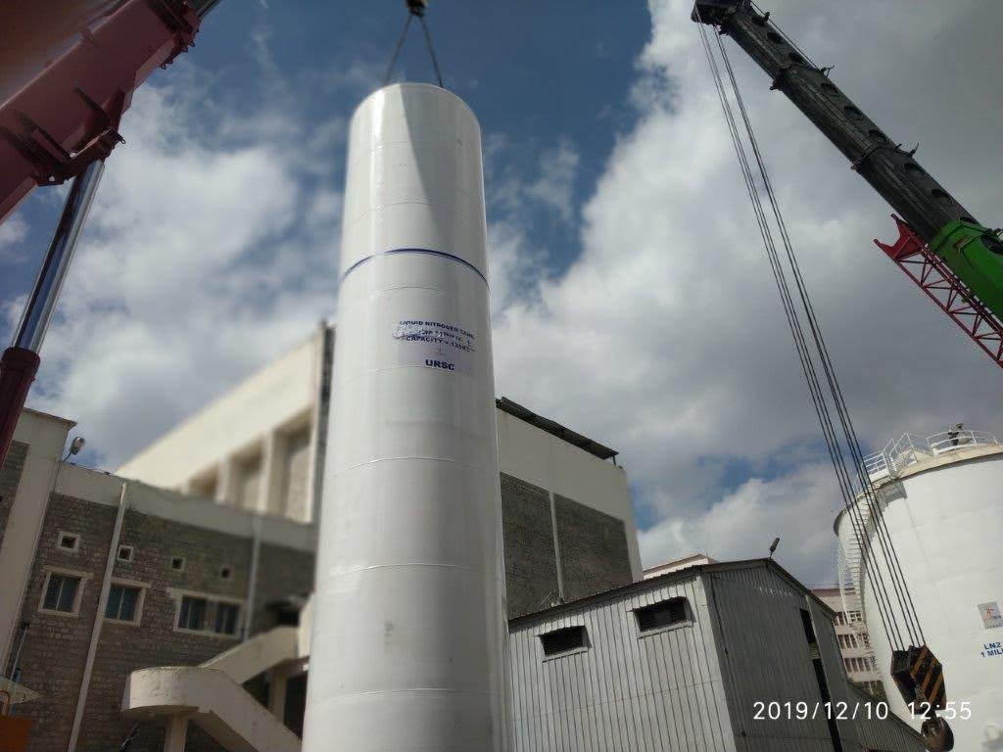
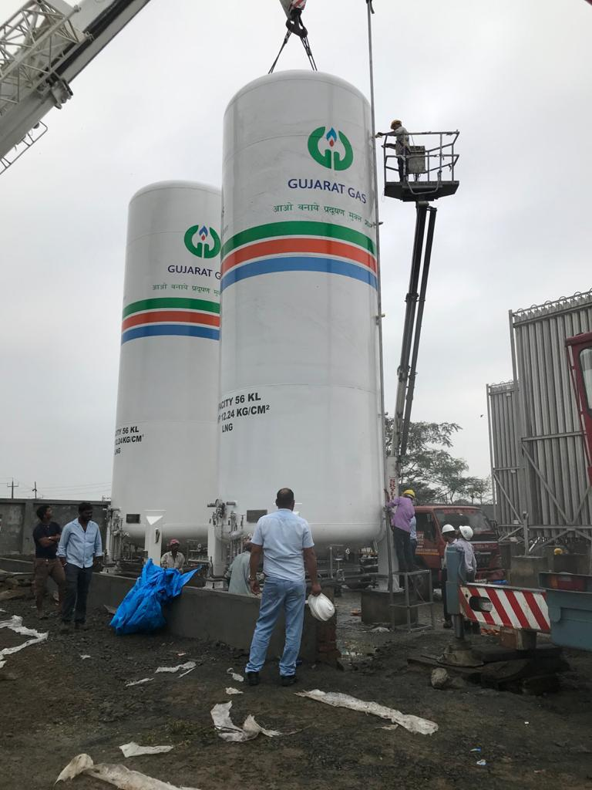
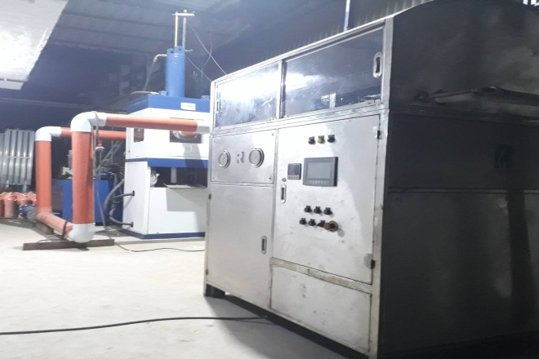
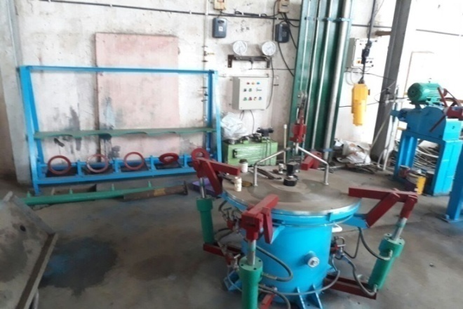
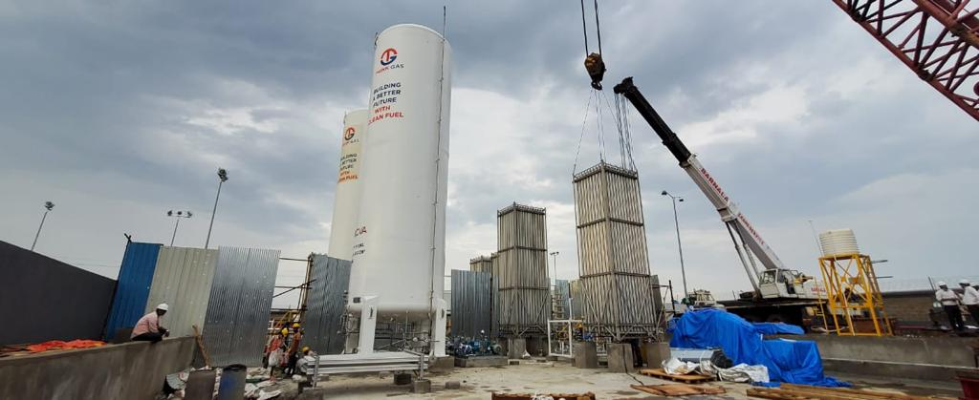
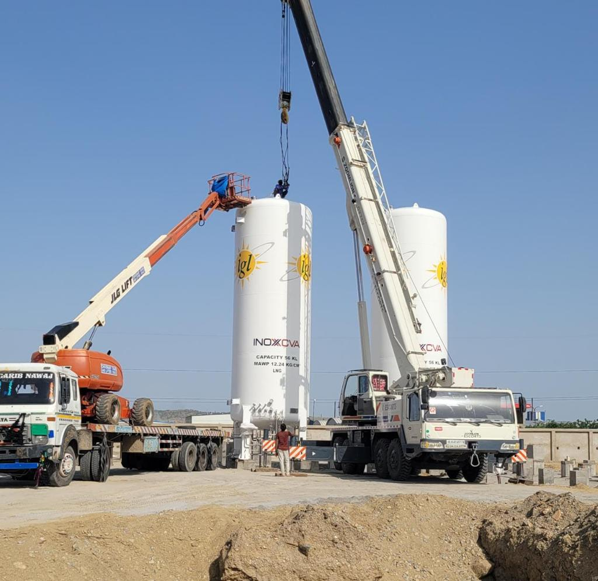
RIZQTECH ENGINEERS
A CONSULTING DESGIN & MANUFACTURING FIRM
PHOTO BOOK
WORKS IT:
486/2 GIDC,
MAKRPURA,
VADODARA-390010
GUJARAT, INDIA
PHONE NO:+91-7600807606
+91-9624690662
E-MAIL: info@rizqtech.co.in
rizq_tech@yahoo.com
WEBSITE: www.riztechengineers.com
ISO 9001:2015
ISO 45001:2018

Slide 15
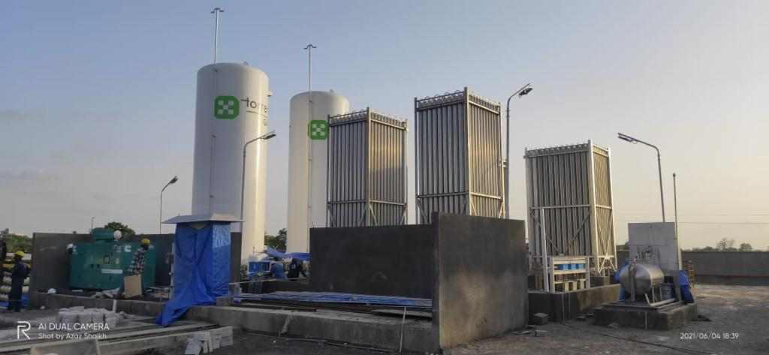
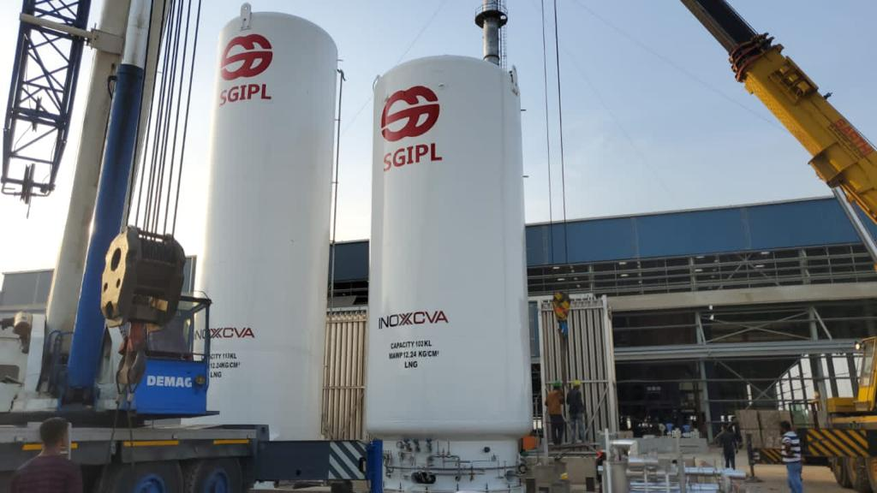
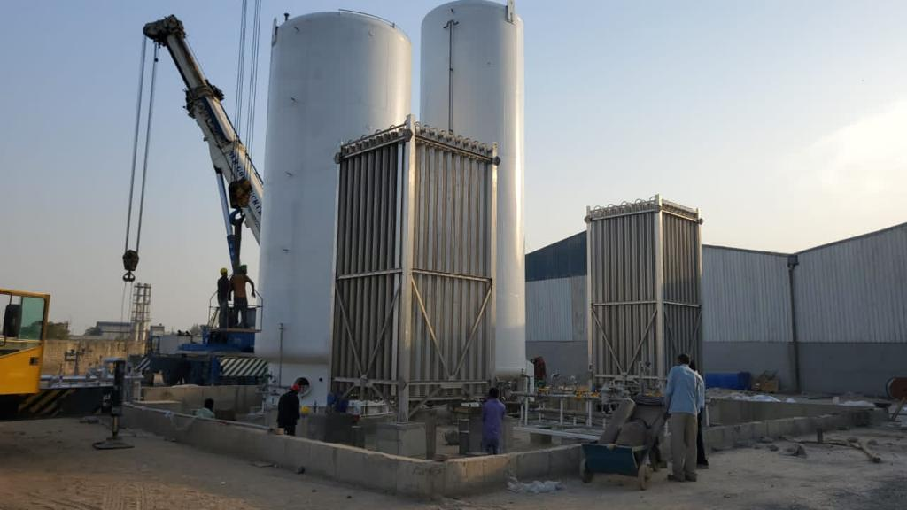
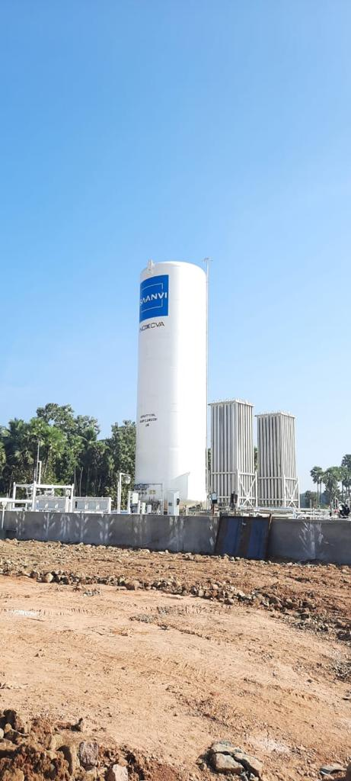
RIZQTECH ENGINEERS
A CONSULTING DESGIN & MANUFACTURING FIRM
PHOTO BOOK
WORKS IT:
486/2 GIDC,
MAKRPURA,
VADODARA-390010
GUJARAT, INDIA
PHONE NO:+91-7600807606
+91-9624690662
E-MAIL: info@rizqtech.co.in
rizq_tech@yahoo.com
WEBSITE: www.riztechengineers.com
ISO 9001:2015
ISO 45001:2018

Slide 16
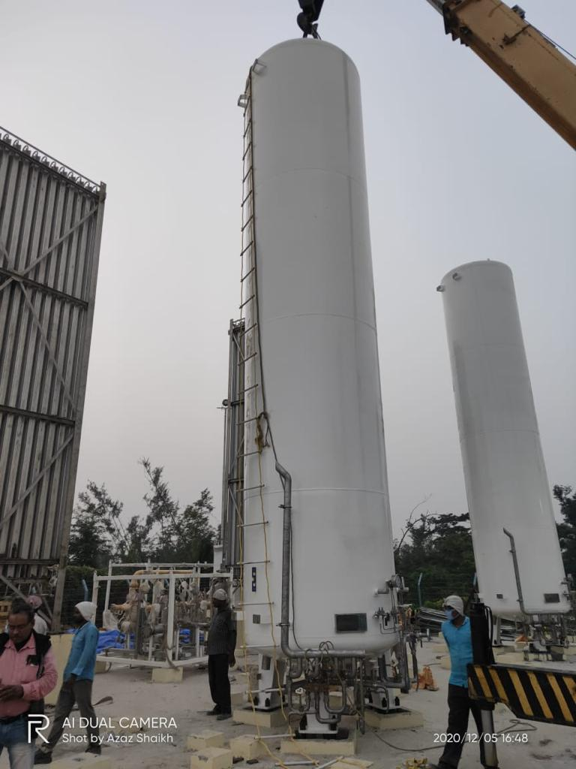



RIZQTECH ENGINEERS
A CONSULTING DESGIN & MANUFACTURING FIRM
PHOTO BOOK
WORKS IT:
486/2 GIDC,
MAKRPURA,
VADODARA-390010
GUJARAT, INDIA
PHONE NO:+91-7600807606
+91-9624690662
E-MAIL: info@rizqtech.co.in
rizq_tech@yahoo.com
WEBSITE: www.riztechengineers.com
ISO 9001:2015
ISO 45001:2018

Slide 17




RIZQTECH ENGINEERS
A CONSULTING DESGIN & MANUFACTURING FIRM
PHOTO BOOK
WORKS IT:
486/2 GIDC,
MAKRPURA,
VADODARA-390010
GUJARAT, INDIA
PHONE NO:+91-7600807606
+91-9624690662
E-MAIL: info@rizqtech.co.in
rizq_tech@yahoo.com
WEBSITE: www.riztechengineers.com
ISO 9001:2015
ISO 45001:2018

Slide 18



RIZQTECH ENGINEERS
A CONSULTING DESGIN & MANUFACTURING FIRM
PHOTO BOOK
Ankleshwar-2019
West Bengal -2019
Uganda Africa-2018/19
WORKS IT:
486/2 GIDC,
MAKRPURA,
VADODARA-390010
GUJARAT, INDIA
PHONE NO:+91-7600807606
+91-9624690662
E-MAIL: info@rizqtech.co.in
rizq_tech@yahoo.com
WEBSITE: www.riztechengineers.com
ISO 9001:2015
ISO 45001:2018

Slide 19
RIZQTECH ENGINEERS
A CONSULTING DESGIN & MANUFACTURING FIRM
Customer list
Aether Industries Limited -Surat, Gujarat
AIMS Fine Chemicals -Bhavnagar, Gujarat
Akshar Air Product - Dahej, Gujarat
Alexa Industrial Gases -Botad, Gujarat
Ashok & Company- Delhi, Gujarat
Aurangabad Carbon Products Pvt Ltd - Aurangabad, Maharashtra
Axis Industrial House- Pithampur, Madhya Pradesh
Bhagyalaxmi Gas Industry - Vadodara, Gujarat
Bicon Corporation - Ahemdabad,Gujarat
Chemtrade Corporation- Mehsana, Gujarat
Dahod Hot Insulation Works -Dahod, Gujarat
Davat Beverages Private Limited -Gondal, Gujarat
Delta Gases – Zambia, Africa
Eureka Fabricators Pvt Ltd. - Mumbai, Maharashtra
Everest Gases -Ahmedabad ,Gujarat
Gayatri Industrial Gases - Padra, Gujarat
Gunlakshmi Metalics Pvt Ltd -Jalna, Maharashtra
Gunnebo India Private Limited- Halol, Gujarat
HPS Gases Limited - Por, Gujarat
Inox India Pvt Ltd.
Icon Welding Equipments -Vadodara, Gujarat
IFB Agro Industries Ltd -Nurpur, West Bengal
Indie Delights Pvt Ltd.- Vadodara, Gujarat
WORKS IT:
486/2 GIDC,
MAKRPURA,
VADODARA-390010
GUJARAT, INDIA
PHONE NO:+91-7600807606
+91-9624690662
E-MAIL: info@rizqtech.co.in
rizq_tech@yahoo.com
WEBSITE: www.riztechengineers.com
ISO 9001:2015
ISO 45001:2018

Slide 20
RIZQTECH ENGINEERS
A CONSULTING DESGIN & MANUFACTURING FIRM
Customer list
Puregas Carbonics Private Limited- Haryana, Punjab
Industrial Gas Corporation- Rourkela, Odisha
Infiniti Gases Pvt Ltd - Surat, Gujarat
Infiniti Retails India Pvt Ltd - Nagothane, Maharashtra
Jai Balaji Oxygen Pvt Ltd - Jharsuguda, West Bengal
Jalan Cryogenics Pvt Ltd – Banur, Punjab
Kanadiya Industrial Gases - Bhavnagar, Gujarat
Krupa Carbonic - Porbandar, Gujarat
Lalan Air Products - Ahmedabad, Gujarat
Loyds Insulation – Vadodara, Gujarat
Maruti Hydro Testing plant - Kapadvanj, Gujarat
MDS Industrial Gases - Dhar, Madhya Pradesh
Moxi Industrial Gases - Moxi, Gujarat
MDL Distillers - Uganda, Africa
Neon Fuel Limited - Rajkot, Gujarat
Noble Gas Ltd. -Gujarat
Ocean Sparkle Ltd - Jamnagar, Gujarat
Panagarh Carbonics - Panagarh, West Bengal
Park Sheldrake - Surat, Gujarat
Pavan Industrial Gases Pvt Ltd.- Mehsana, Gujarat
P K Carbonics - Vapi, Gujarat
PT Cold Solution India Private Limited - Mumbai, Maharashtra
WORKS IT:
486/2 GIDC,
MAKRPURA,
VADODARA-390010
GUJARAT, INDIA
PHONE NO:+91-7600807606
+91-9624690662
E-MAIL: info@rizqtech.co.in
rizq_tech@yahoo.com
WEBSITE: www.riztechengineers.com
ISO 9001:2015
ISO 45001:2018

Slide 21
RIZQTECH ENGINEERS
A CONSULTING DESGIN & MANUFACTURING FIRM
Customer list
Rajasthan Liquors Limited - Jaipur, Rajasthan
Rishi Carbonic Pvt Ltd- Ambala, Punjab
R R Patel Gases Pvt Ltd-Ahmedabad, Gujarat
R R Patel Industrial Gases Private Limited - Ahmedabad, Gujarat
Salasar Carbonic Pvt Ltd - Jaipur, Rajasthan
Seforge Limited - Vadodara, Gujarat
Shakti Industrial Gases - Vadodara, Gujarat
Shiv Kripa Gases And Metals Pvt Ltd. - Batala, Punjab
Shree Balaji Gas Industries- Vashi, Maharashtra
Shreeji Acetylene Co. (Unit-2) - Palsana, Gujarat
Shree Kailaji Gases - Kheda, Gujarat
Shree Ved Chemical and Gases - Vadodara, Gujarat
Sky Oxygen Co Limited - Vadodara, Gujarat
Steel man Gases Pvt Ltd. - Surat, Gujarat
Supreme Bottling - Botad, Gujarat
Supreme Gases - Botad, Gujarat
Sterling Biotech Ltd - Masar, Gujarat
Sun Pharmaceutical Industries Ltd. - Vadodara, Gujarat
Trimurti Carbonic - Junagadh, Gujarat
U P Cryogenics - Karnal Uttar Pradesh
Varia Carbonic Industries - Rajkot, Gujarat
Verni Gastech Pvt Ltd.- Bharuch, Gujarat
WORKS IT:
486/2 GIDC,
MAKRPURA,
VADODARA-390010
GUJARAT, INDIA
PHONE NO:+91-7600807606
+91-9624690662
E-MAIL: info@rizqtech.co.in
rizq_tech@yahoo.com
WEBSITE: www.riztechengineers.com
ISO 9001:2015
ISO 45001:2018

Slide 22
RIZQTECH ENGINEERS
A CONSULTING DESGIN & MANUFACTURING FIRM
Customer list
Wilson Cryo Gases -Jaipur, Rajasthan
Western Drugs Limited - Udaipur,Rajasthan
Eximotek India Pvt Ltd - Bengluru
Big Peenya Group -Punjab
Virgo Aluminum-kheda
Airforce- Jaisalmer
Hindustan National Glass Industries Limited-Nashik
Camavi electricals Pvt Ltd-Murbad
Ogeru carbonics Pvt Ltd-Vijaywada
WORKS IT:
486/2 GIDC,
MAKRPURA,
VADODARA-390010
GUJARAT, INDIA
PHONE NO:+91-7600807606
+91-9624690662
E-MAIL: info@rizqtech.co.in
rizq_tech@yahoo.com
WEBSITE: www.riztechengineers.com
ISO 9001:2015
ISO 45001:2018

Slide 23
RIZQTECH ENGINEERS
A CONSULTING DESGIN & MANUFACTURING FIRM
CONTACT
RIZQTECH ENGINEERS. - MAIN OFFICE
486/2,GIDC MAKARPURA
VADODARA(GUJARAT),INDIA-390010
PHONE NUMBERS:
+91 7600807606
+91 9624690662
EMAIL:
info@rizqtech.co.in
rizq_tech@yahoo.com
www.rizqtechengineers.com
WORKS IT:
486/2 GIDC,
MAKRPURA,
VADODARA-390010
GUJARAT, INDIA
PHONE NO:+91-7600807606
+91-9624690662
E-MAIL: info@rizqtech.co.in
rizq_tech@yahoo.com
WEBSITE: www.riztechengineers.com
ISO 9001:2015
ISO 45001:2018

